Slide 1
Using big data to tell human stories
Data journalism's democratic revolution, or why there's never been a better time to tell data-driven stories
Ilia Blinderman
The Pudding
Notes:
Couple of points:
1. human stories
2. I’ll be making some refernces to academia since that’s a large part of my background

Slide 2
What we’ll cover
Background: The Pudding
i. The data
ii. The medium
iii. The tools
iv. The skills
v. Some reservations

Slide 3
Background

Slide 4
My background
Education
McGill, BA ‘11- Psych & Poli Sci
McGill, MSc ‘13 - Psychiatry
Columbia Lede, ‘14
Work
Academic editor, ’13-‘14
Freelance writer, ’13-‘15
Freelance data journalist, ‘15
The Pudding - Journalist-Engineer, ‘16
Notes:
-Emphasize lack of technical background before ’14
-run through history here

Slide 5
What we do
The Pudding - Mission
Tell stories that are worthy of debate/discourse
Aim for shelf life
Show, don’t tell
Notes:
Emphasize lack of technical background before ‘14

Slide 6
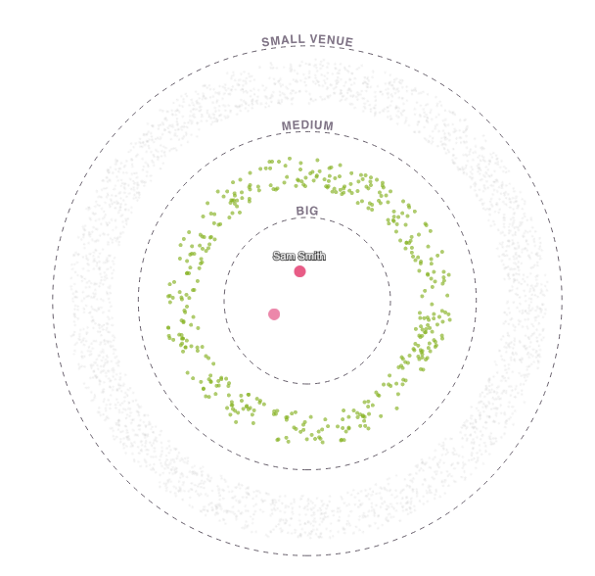
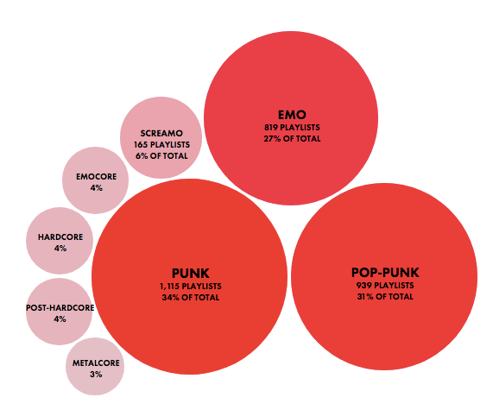
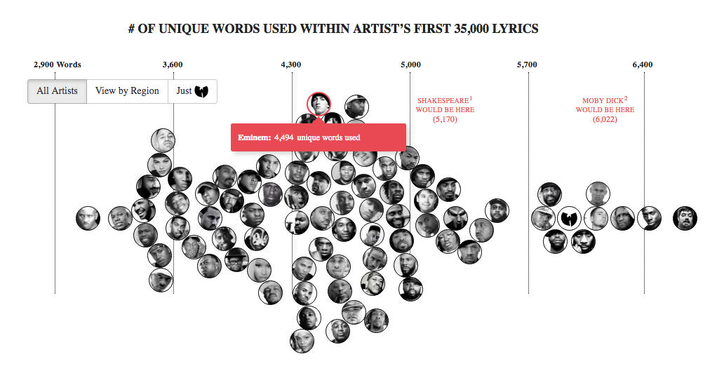
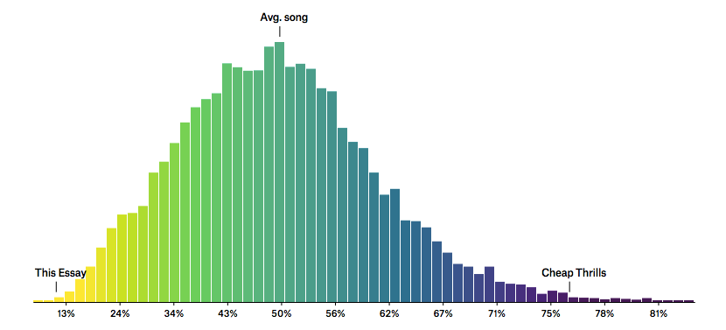
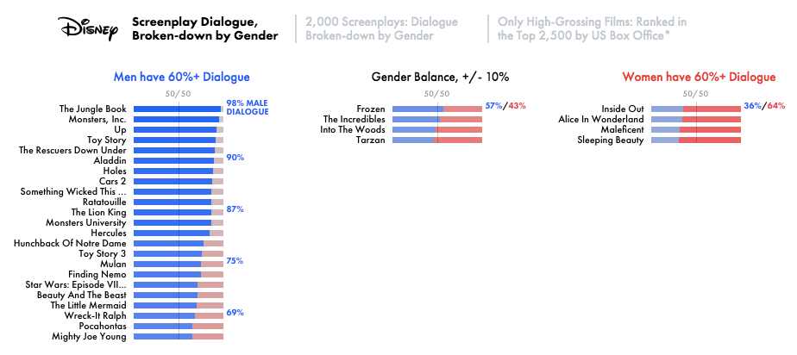
Our Projects

Slide 7
Who has the largest vocabulary
in hip hop?

Slide 8
How many musicians have made it big
in the recent years?

Slide 9
What are the political consequences of
job automation in America?

Slide 10
What is the gender dialogue
breakdown of films?

Slide 11
How does abortion clinic accessibility
vary by geography?

Slide 12
i. The data

Slide 13
i. The data
My first project
Notes:
https://gizmodo.com/5985509/this-map-of-the-united-states-of-america-shows-where-cragslist-missed-connections-happen-in-each-state
http://www.verysmallarray.com/

Slide 14
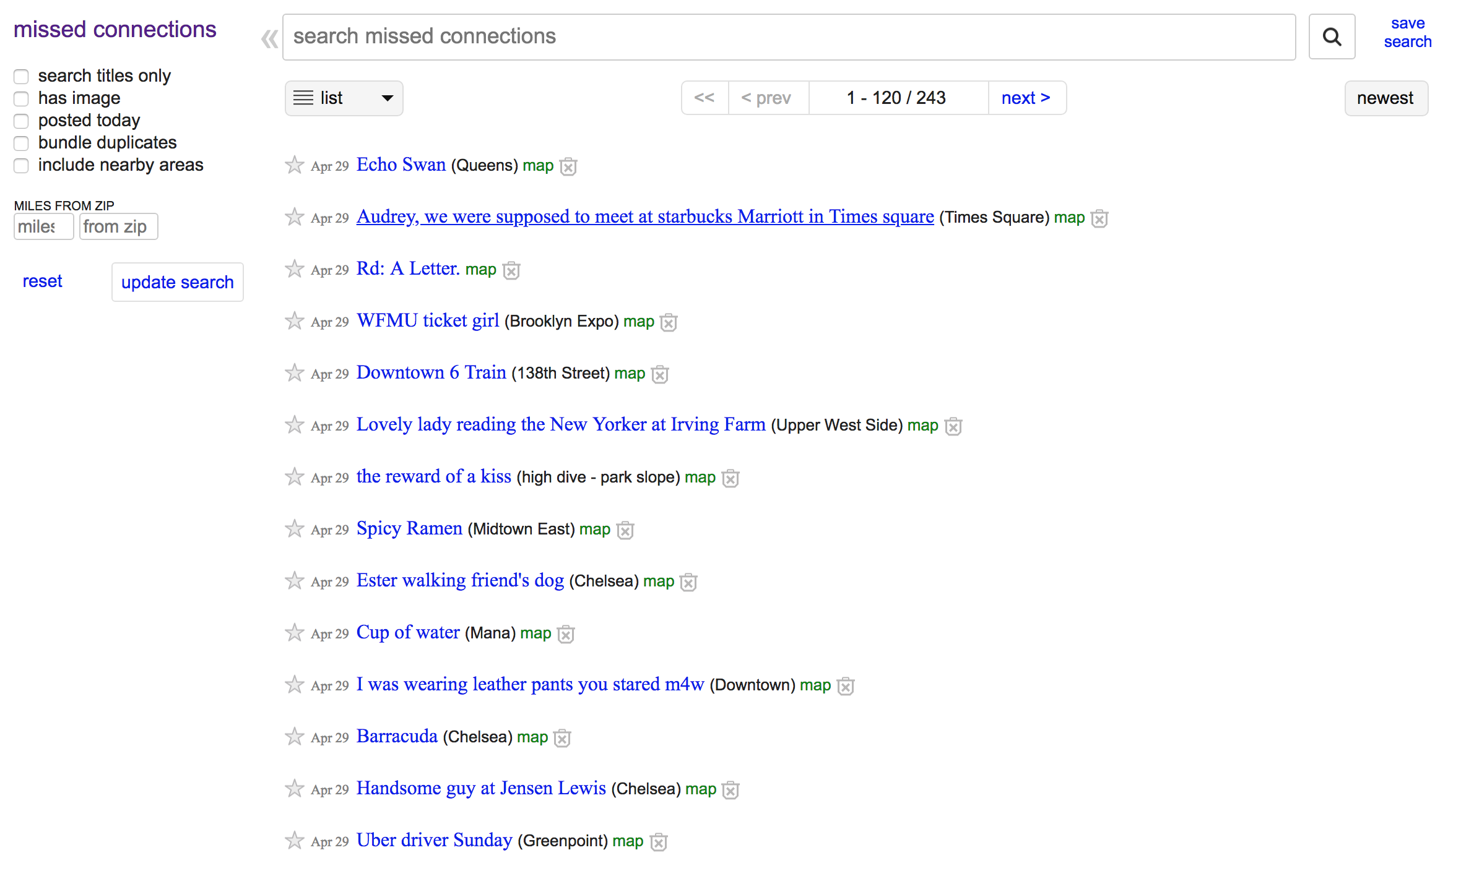
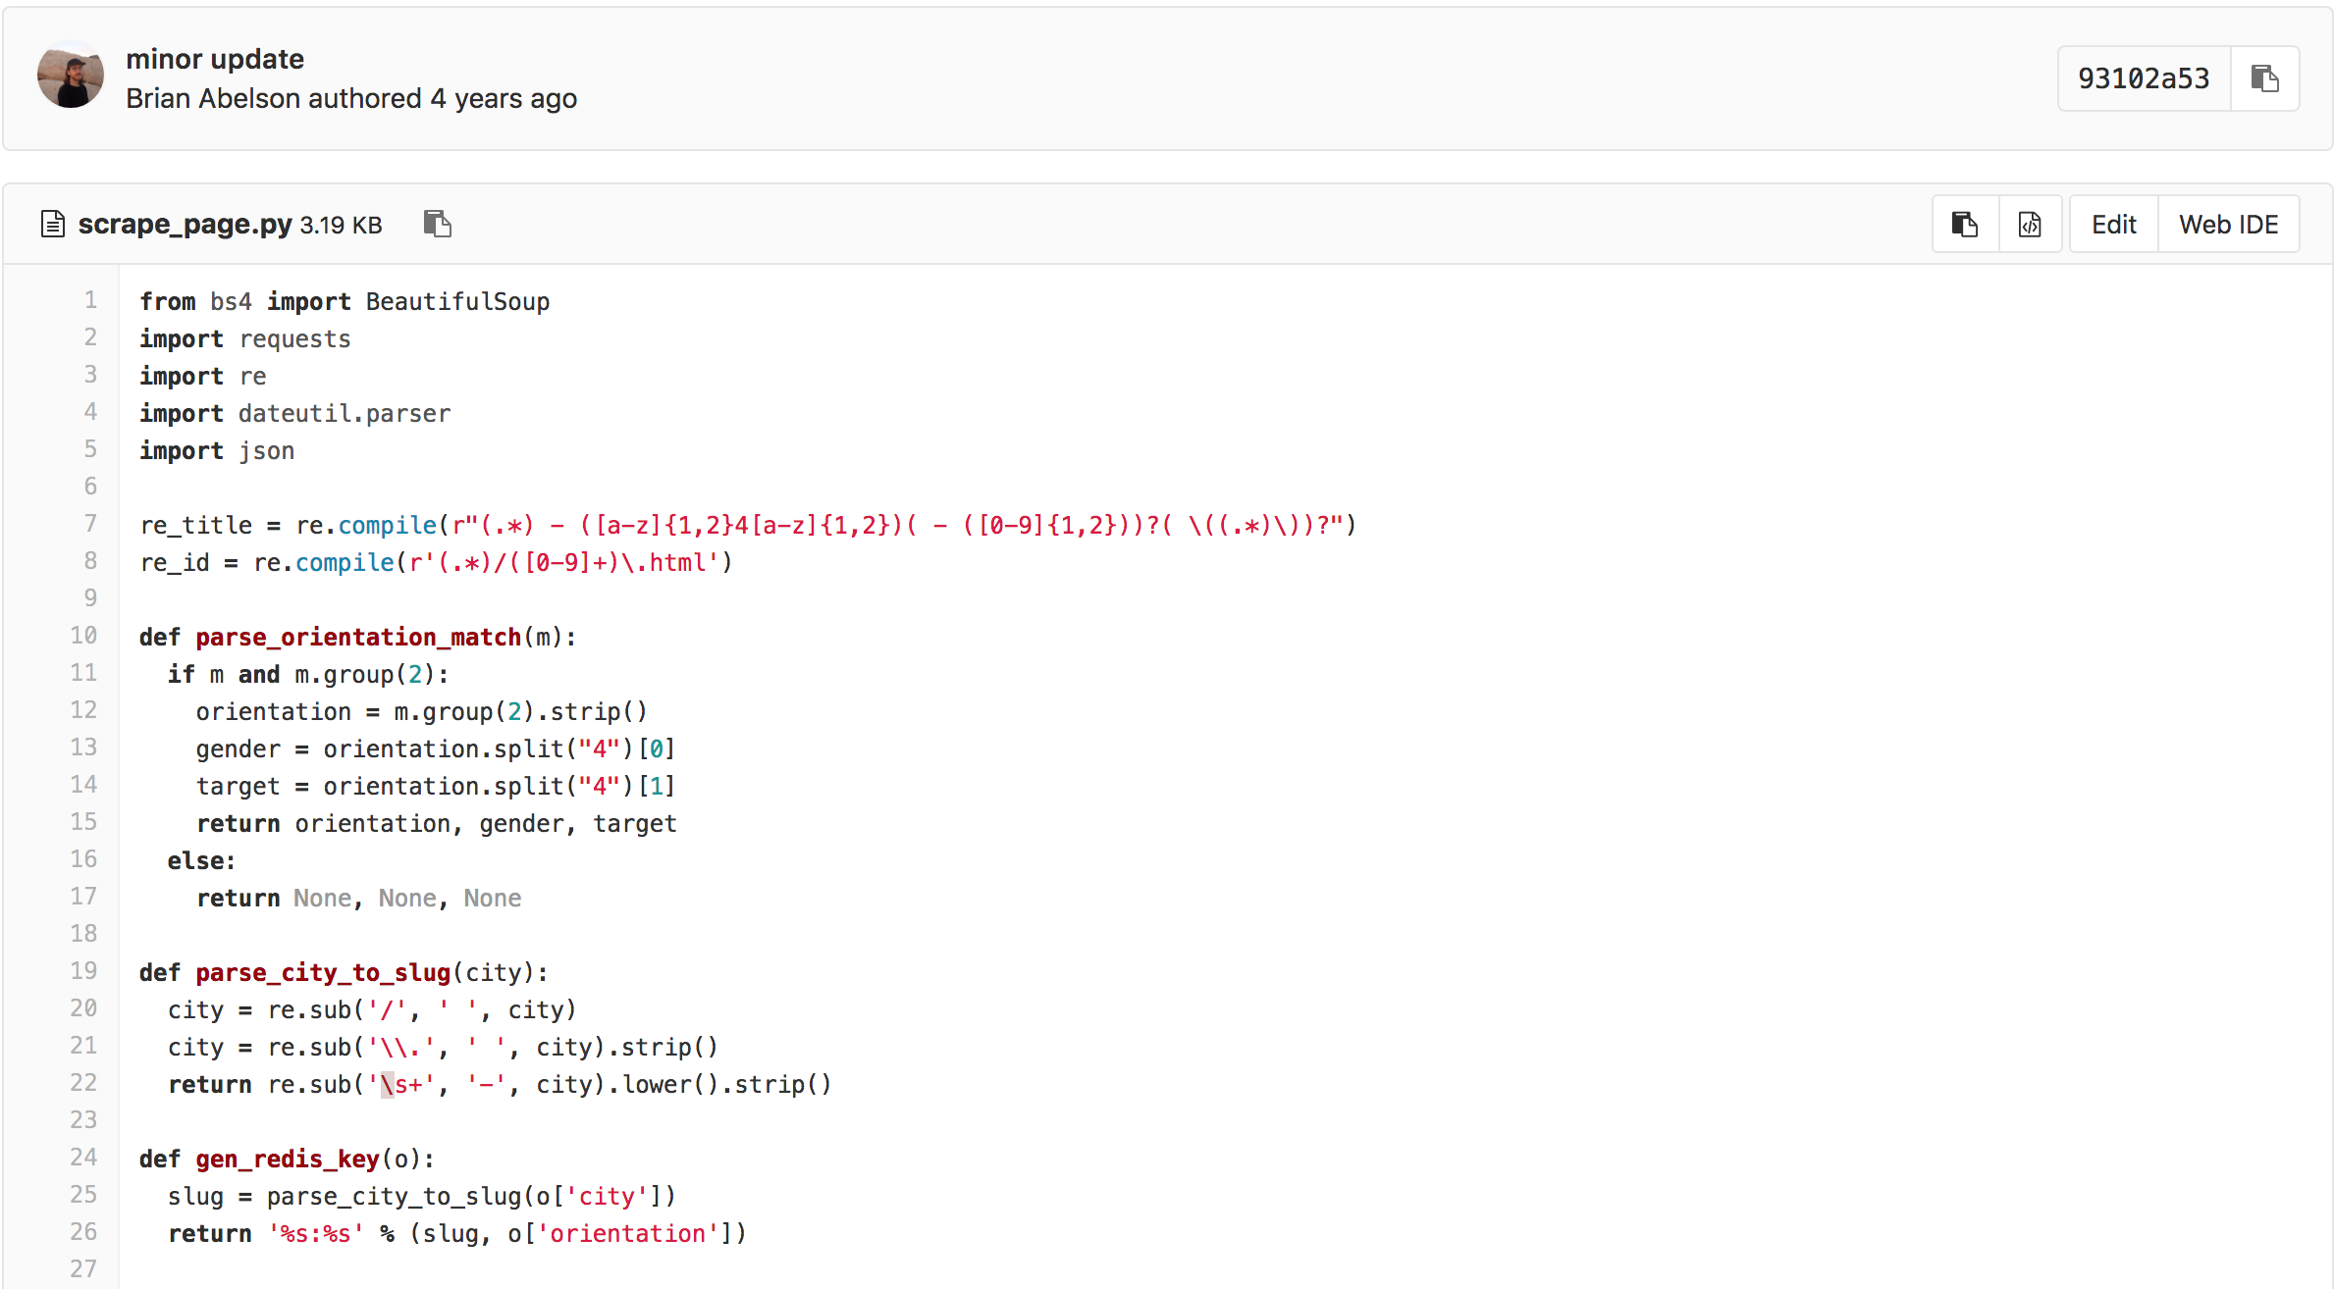
i. The data
My first project
Notes:
https://gitlab.com/csv/mc-api/blob/master/crawler/scrape_page.py
https://gitlab.com/csv/mc-api

Slide 15
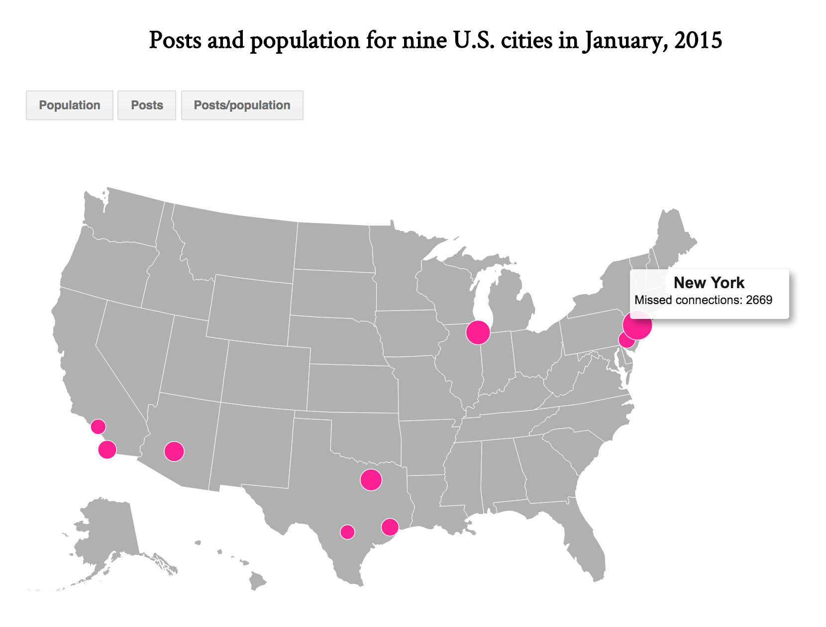
i. The data
My first project

Slide 16
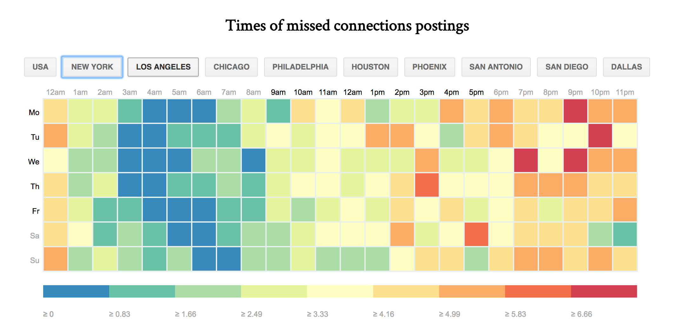
i. The data
My first project

Slide 17
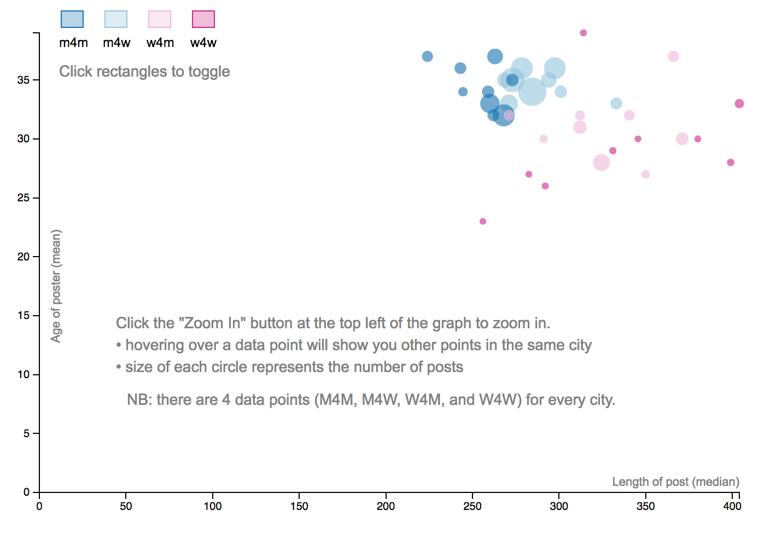
i. The data
My first project

Slide 18
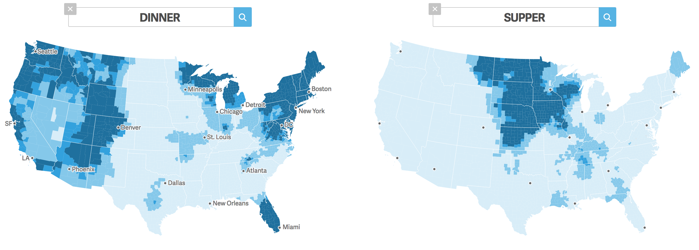
i. The data
Jack Grieve’s linguistic research
Notes:
https://qz.com/862325/the-great-american-word-mapper/#int/words=dinner_supper&smoothing=3

Slide 19
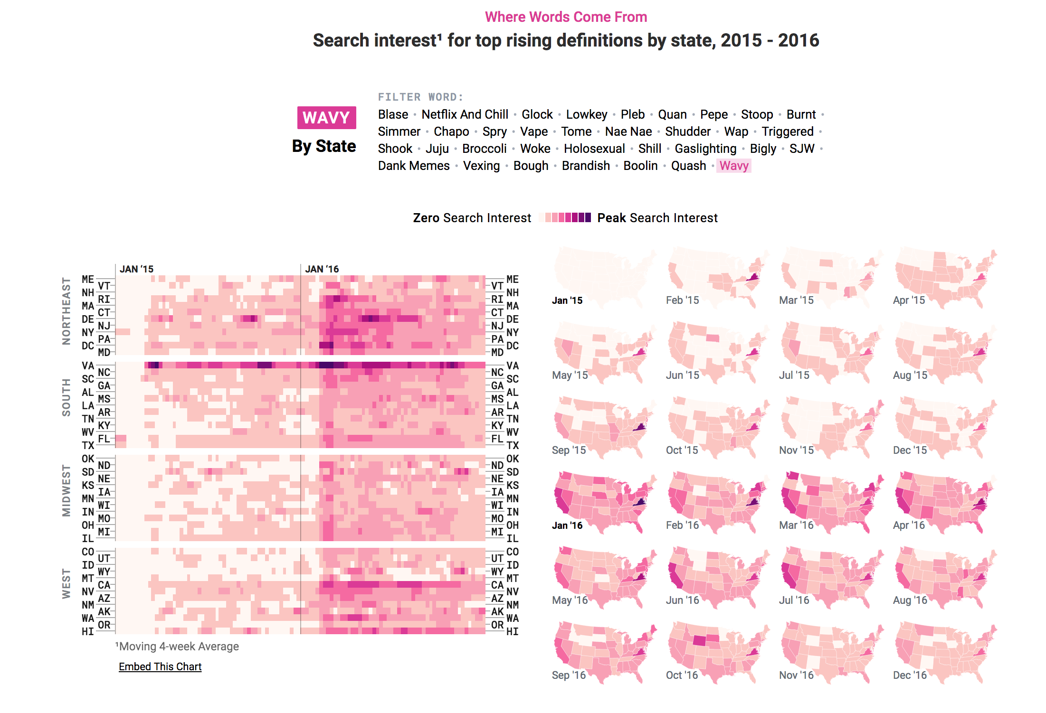
i. The data
The Pudding’s slang research
Notes:
https://pudding.cool/2017/02/new-slang/

Slide 20
i. The data
Public data sources
- US Census data
- Open data, by city
- Various government agencies
- Kaggle
- Wikipedia
- Enigma
- Academic articles
- Freedom of Information Act requests*
- Reddit
- Random corners of the internet
- Github
Notes:
CENSUS (need to register)
https://live.identity.popdata.org/idp/profile/SAML2/Redirect/SSO
CENSUS (available)
https://factfinder.census.gov/faces/nav/jsf/pages/searchresults.xhtml?refresh=t
Wiki
http://wiki.dbpedia.org/develop/datasets
https://en.wikipedia.org/wiki/List_of_Brooklyn_neighborhoods
Academic Articles
http://scholar.google.com/
Reddit
https://www.reddit.com/r/dataisbeautiful/search?q=neighborhood&restrict_sr=1
Github
https://github.com/awesomedata/awesome-public-datasets
Open data, by city
https://opendata.cityofnewyork.us/
Kaggle
https://www.kaggle.com/datasets?sortBy=relevance&group=public&search=neighborhood&page=1&pageSize=20&size=all&filetype=all&license=all
Enigma
https://public.enigma.com/
Random corners of the internet
http://users.stat.ufl.edu/~winner/datasets.html

Slide 21
ii. The tools

Slide 22

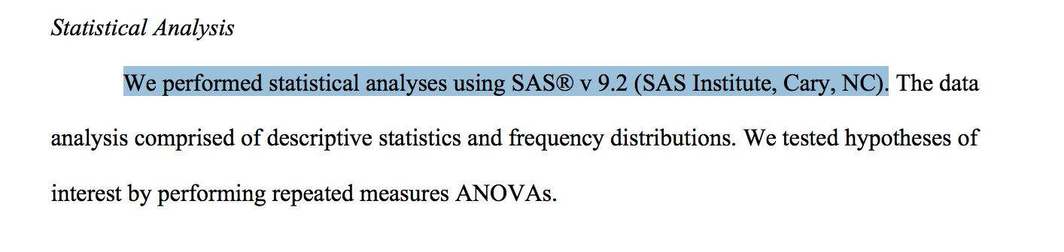
ii. The tools
My data analyses in academia
Notes:
SPSS and SAS.
Charts in excel (and viz like this: https://twitter.com/wtfviz?lang=en)

Slide 23
ii. The tools
Analytical tools in visual, data-driven storytelling
- R
- Python
- JavaScript
Each of these have a tremendous amount of public support & documentation
(https://stackoverflow.com/)

Slide 24
ii. The tools
Visualizing data: tools
- Pen & Paper
- Chartbuilder
- QGIS/ArcGIS
- Figma/Illustrator
- Datawrapper
- D3
- Keynote/Google slides
- Highcharts
- Tableau
- Excel
- Pandas
- Observable
- R
Notes:
Everything I’ve highlighted here is free!
Show figma for neighborhoods here, and end project.

Slide 25
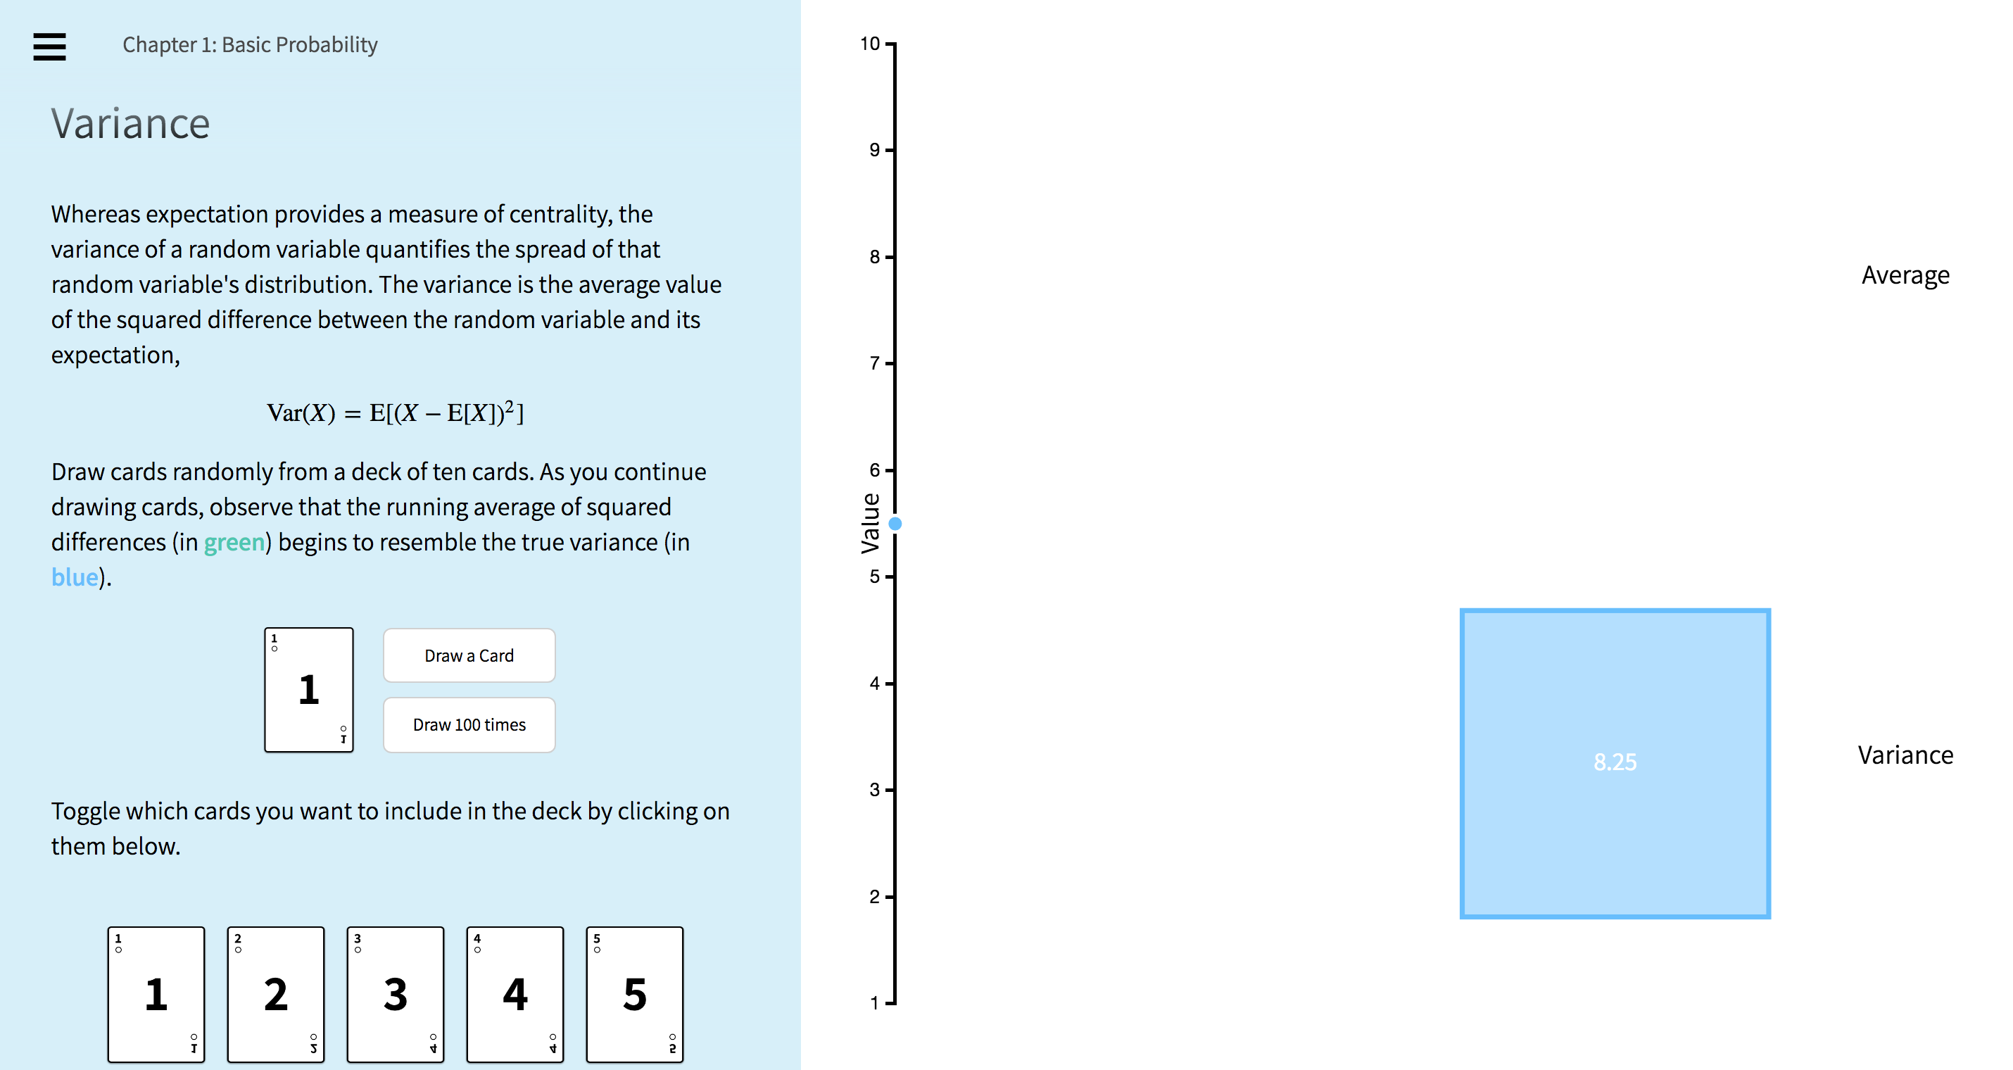
ii. The tools
Wielded by students and researchers alike
Notes:
http://students.brown.edu/seeing-theory/index.html

Slide 26
ii. The tools
The mysterious 65,536

Slide 27

ii. The tools
Vast quantities of data are now open for analysis
Notes:
Live demo:
https://bigquery.cloud.google.com/results/google.com:about-bracket-stories:US.bquijob_489fe057_163141a6a71?pli=1

Slide 28
iii. The medium

Slide 29
iii. The medium
Charles Minard: Napoleon’s march on Moscow, 1869
Notes:
Six types of data represented: the number of Napoleon's troops; distance; temperature; the latitude and longitude; direction of travel; and location relative to specific dates

Slide 30
iii. The medium
Denise Lu: Total solar eclipse, 2017
Notes:
https://www.washingtonpost.com/graphics/national/eclipse/?utm_term=.f95be096f52d

Slide 31
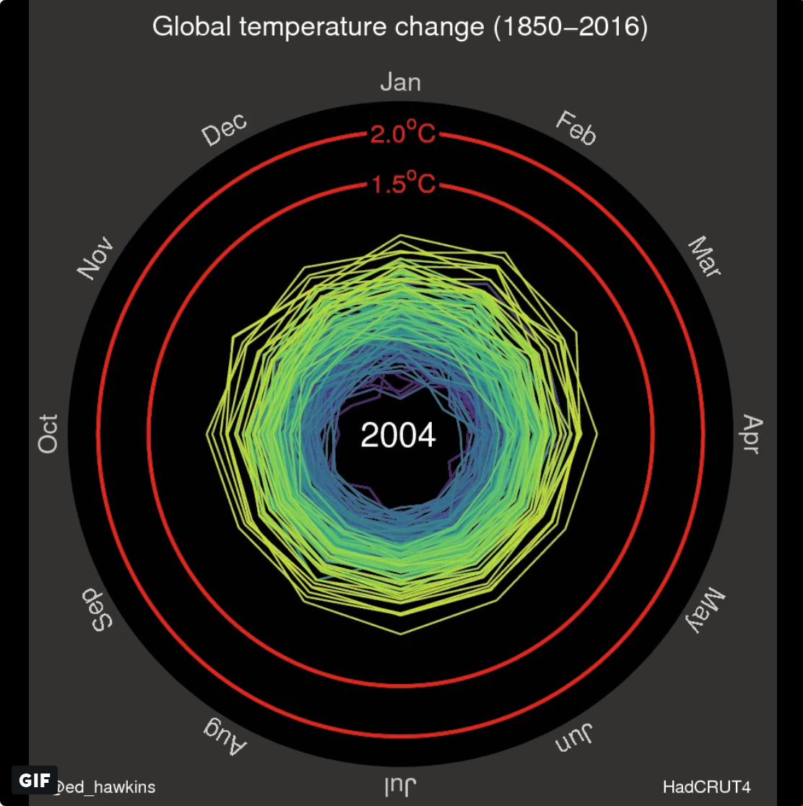
iii. The medium
Ease of sharing
Notes:
Q: does anyone remember this graphic?
Emerged in 2016 from Ed Hawkins, a climate researcher at the university of reading.
15K retweets
11K shares

Slide 32
iv. The skills
Notes:
Intro:
-what do I mean by skills?
-critical thinking
-background knowledge
it’s good to have skills, but the only way you’re going to wield them in an interesting an original way is if you have other interests.

Slide 33





iv. The skills
Amber Thomas
Matt Daniels
Jan Diehm
Ilia Blinderman
Russell Goldenberg
Notes:
How each team member came to data-driven storytelling
Huge breadth of backgrounds, skills, interests.
Most aren’t formally trained in computer science.

Slide 34
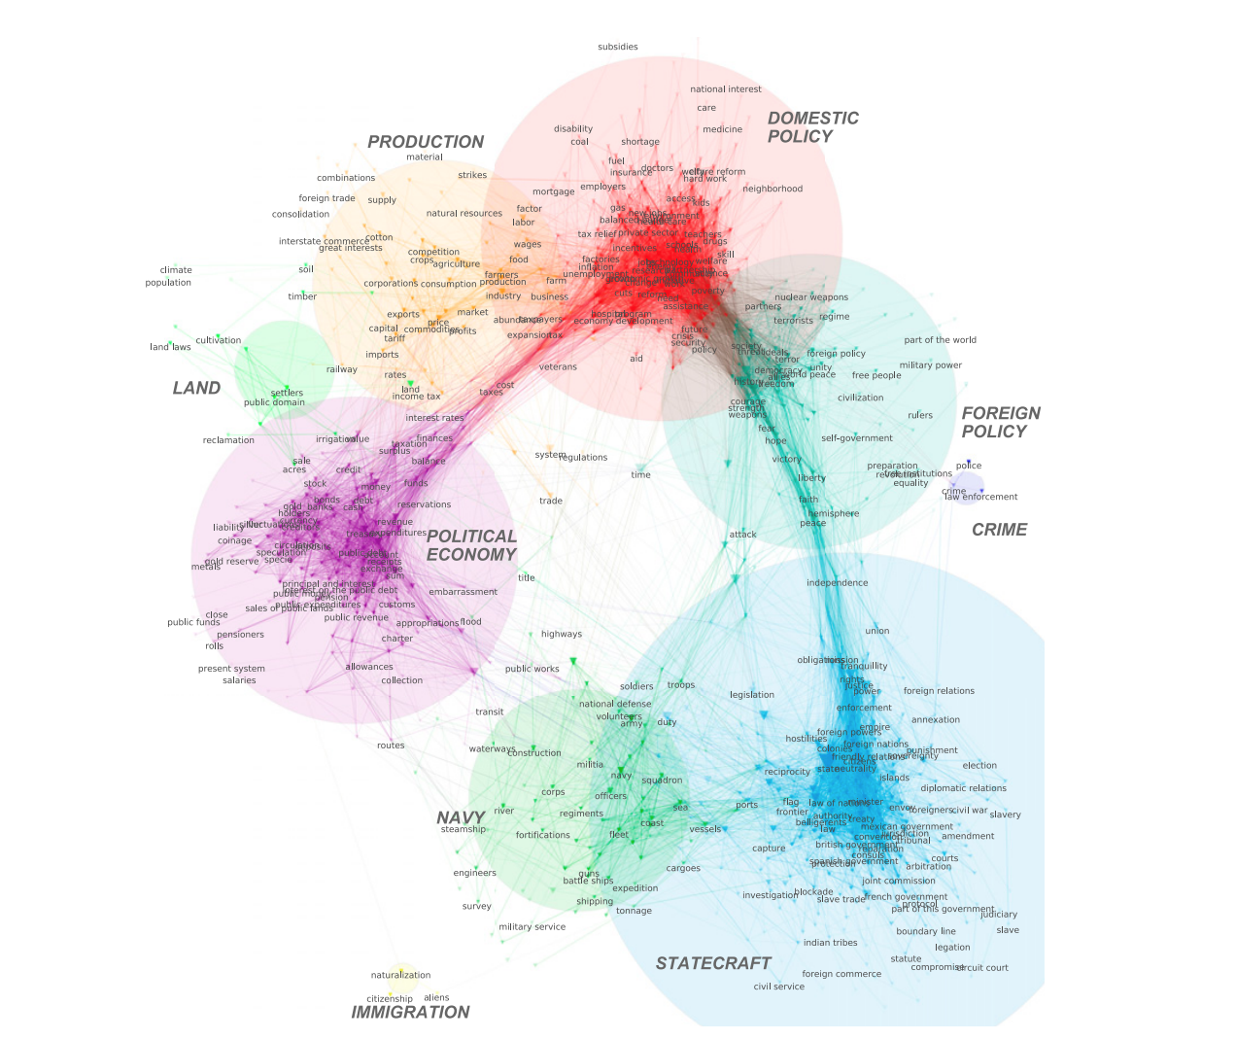
iv. The skills
Notes:
Lexical shifts, substantive changes, and continuity in
State of the Union discourse, 1790–2014

Slide 35
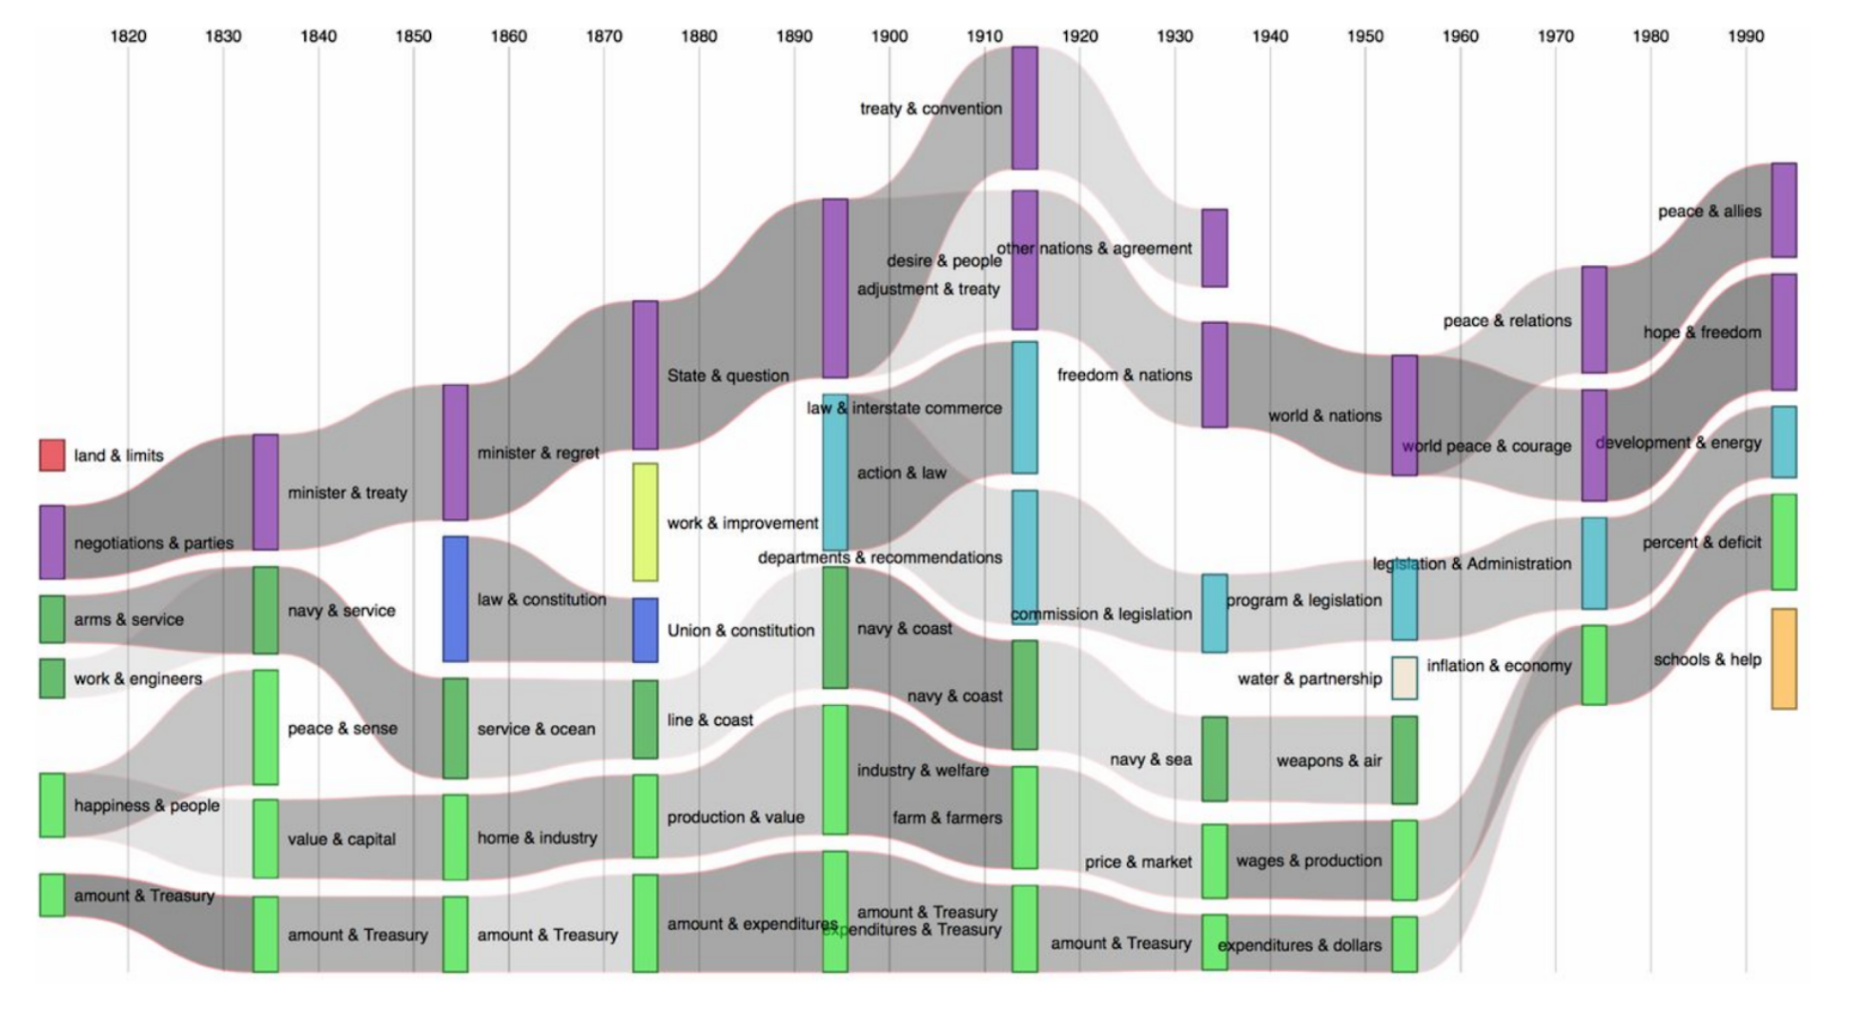
Lexical shifts, substantive changes, and continuity in
State of the Union discourse, 1790–2014
iv. The skills
Notes:
Lexical shifts, substantive changes, and continuity in State of the Union discourse, 1790–2014

Slide 36
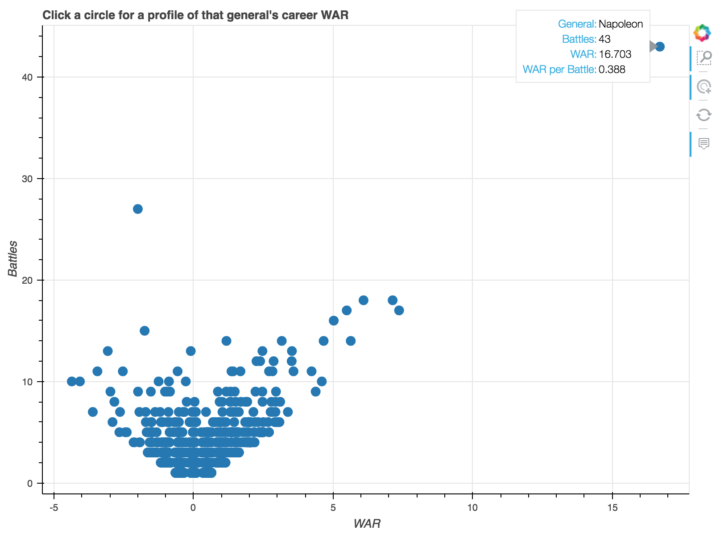
Lexical shifts, substantive changes, and continuity in
State of the Union discourse, 1790–2014
iv. The skills

Slide 37
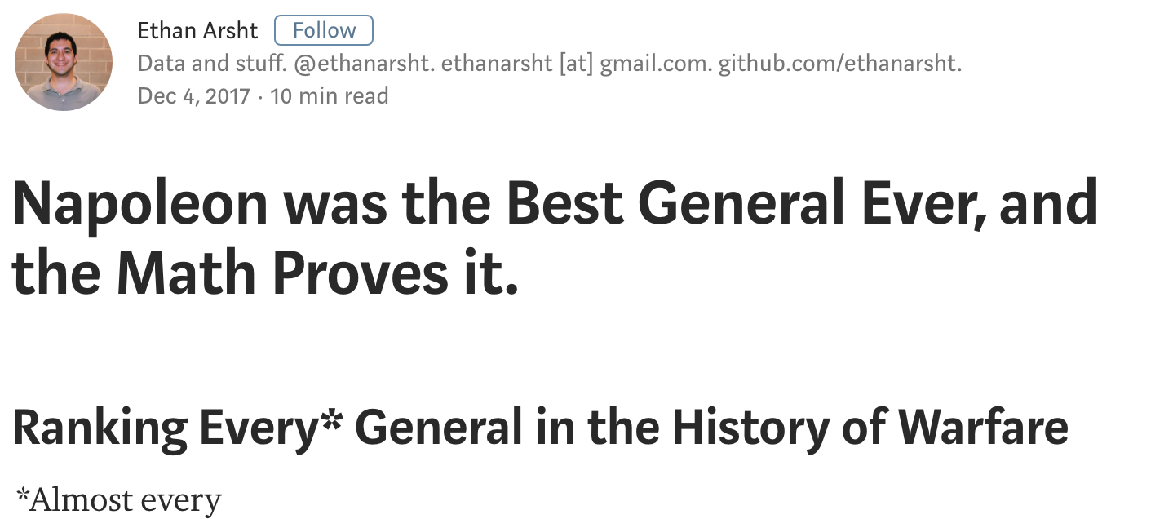
iv. The skills
Notes:
When Africanus asked who, in Hannibal’s opinion, was the greatest general, Hannibal named Alexander… as to whom he would rank second, Hannibal selected Pyrrhus… asking whom Hannibal considered third, he named himself without hesitation. Then Scipio broke into a laugh and said, “What would you say if you had defeated me?”
—Livy
note: he is an undergrad student

Slide 38
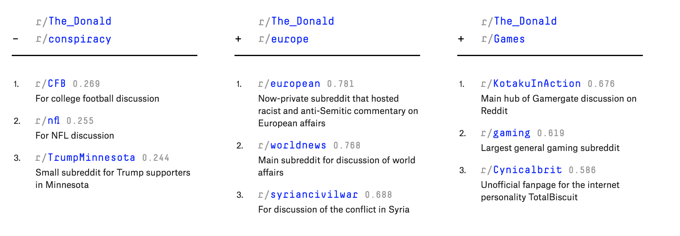
iv. The skills
Dissecting Trump's Most Rabid Online Following

Slide 39
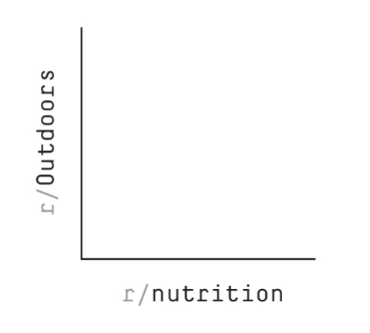
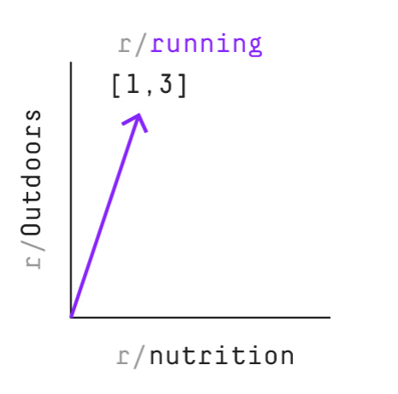
iv. The skills
Dissecting Trump's Most Rabid Online Following

Slide 40
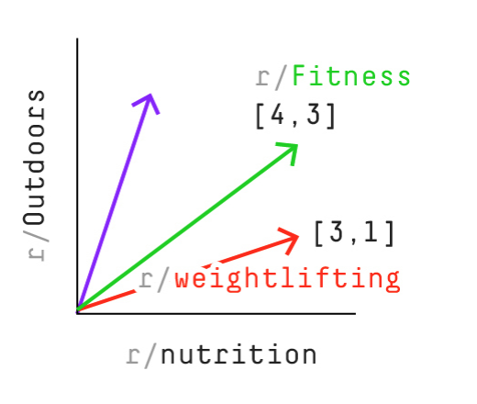
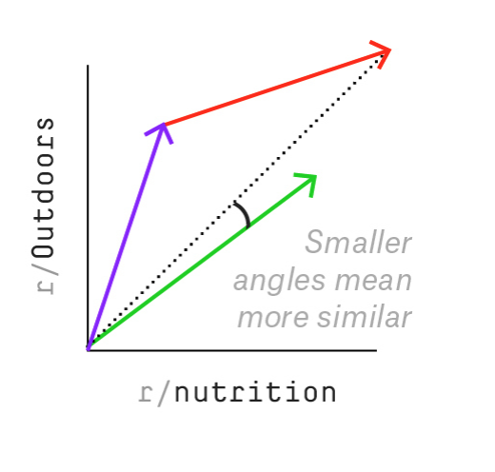
iv. The skills
Dissecting Trump's Most Rabid Online Following
Notes:
note: he is a grad student in stats

Slide 41
v. Some reservations

Slide 42
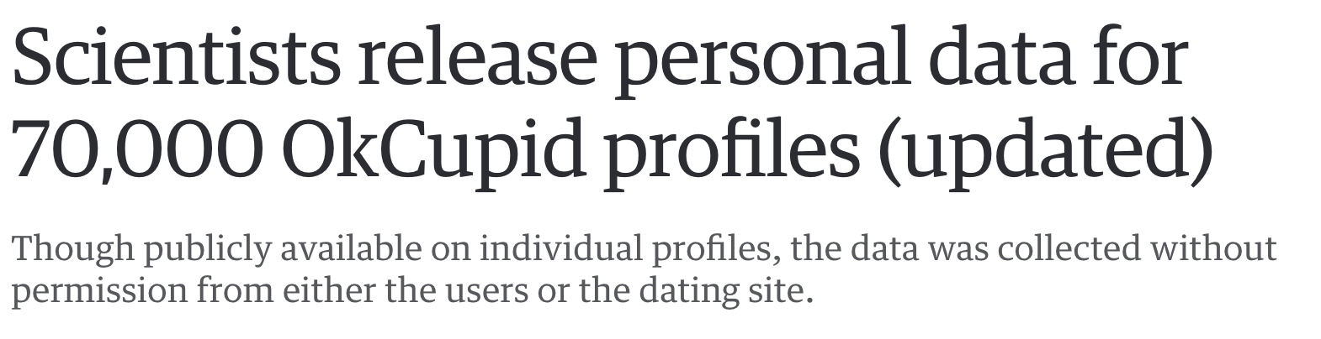
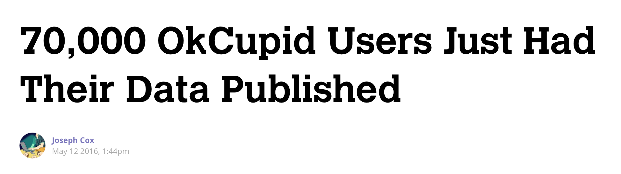
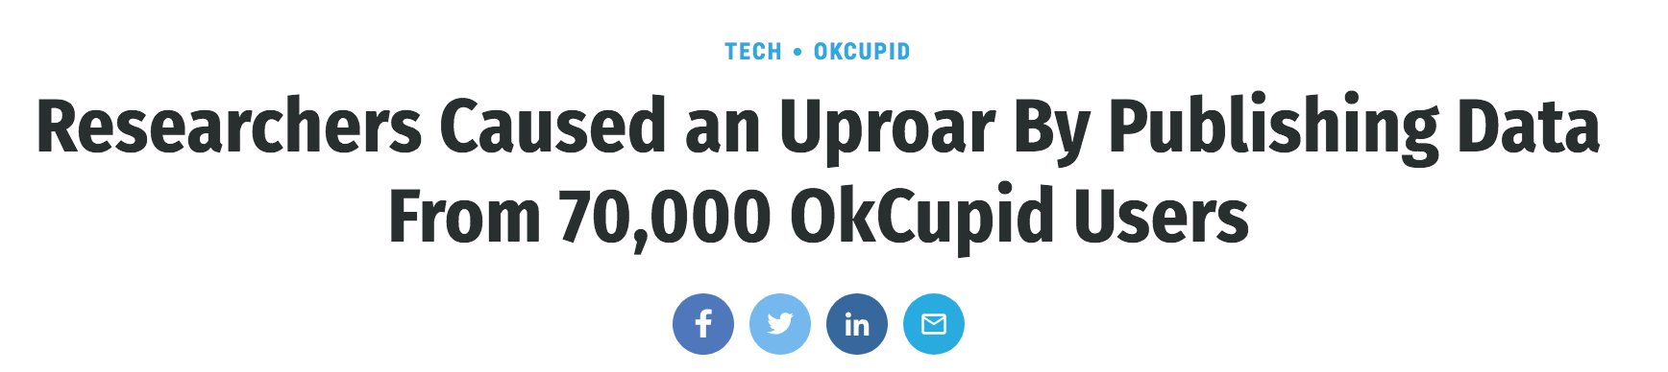
v. Some reservations
There is no IRB

